Slide 1
Knowledge Lesson
Vladislav zolotukhin

Slide 2

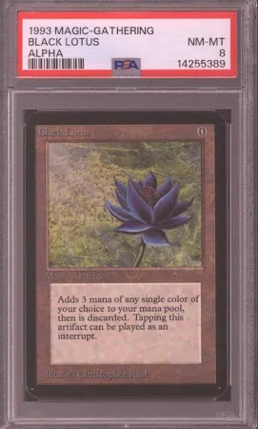
What, where, why
WHAT: Today you’ll be learning about Magic The Gathering
WHERE: You’ll be able to use the information retained from this lesson to play the game anywhere with friends, total strangers, or just use the general knowledge you’ve attained to impress others in conversations
WHY: It’s fun, it brings people together, it helps develop critical thinking skills, and the cards themselves have collector value.

Slide 3
Lesson breakdown
Today we will cover the following topics:
First we will go over what Magic The Gathering is and how it was created
Second we will discuss the basic rules on how to play the game.
Some of you may already be familiar with the game in which case this will serve as a refresher for you.

Slide 4
Questions?
Please raise your hand if you have any questions
At the end of this lesson, there will be a brief period for the audience to cover some of the things we learned today, so please make sure you are attentive.
If at any point during this lesson you feel that you need to use the bathroom, please raise your hand. If at any point I have a question for you, I will choose you. Please do not answer together as a class.

Slide 5
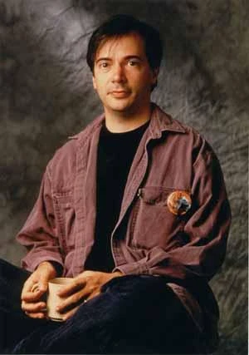
Stage 1: What is magic the gathering?
Trading Card Game (TCG) created by Richard Garfield

Slide 6

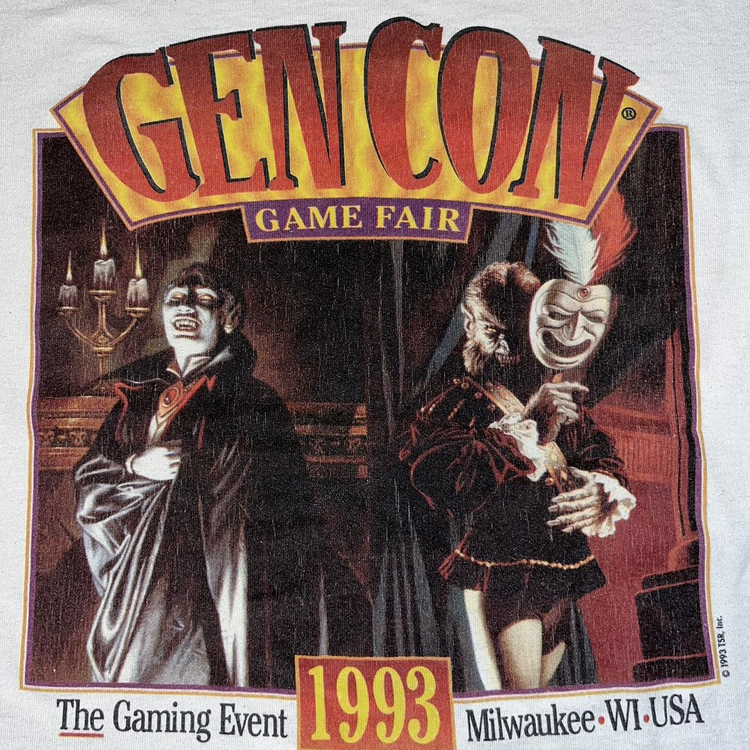
Stage 1: What is magic the gathering?
First published by Wizards of the Coast who wanted a small compact game that people could play during their downtime
Portable, fast gameplay
Don’t need to have all the cards to play, you can pick and choose, you don’t know what cards other players have so each game is different
Debut in GEN CON in August 1993, immediately sold out its initial stock of 2.5 million cards
Sold out another 7.5 million cards by October 1993 just by word of mouth advertising
Over 1 billion cards produced in its first year of existence, beginning a cycle of new expansions, refreshes, and supplements that would last for decades

Slide 7
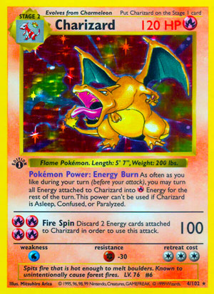
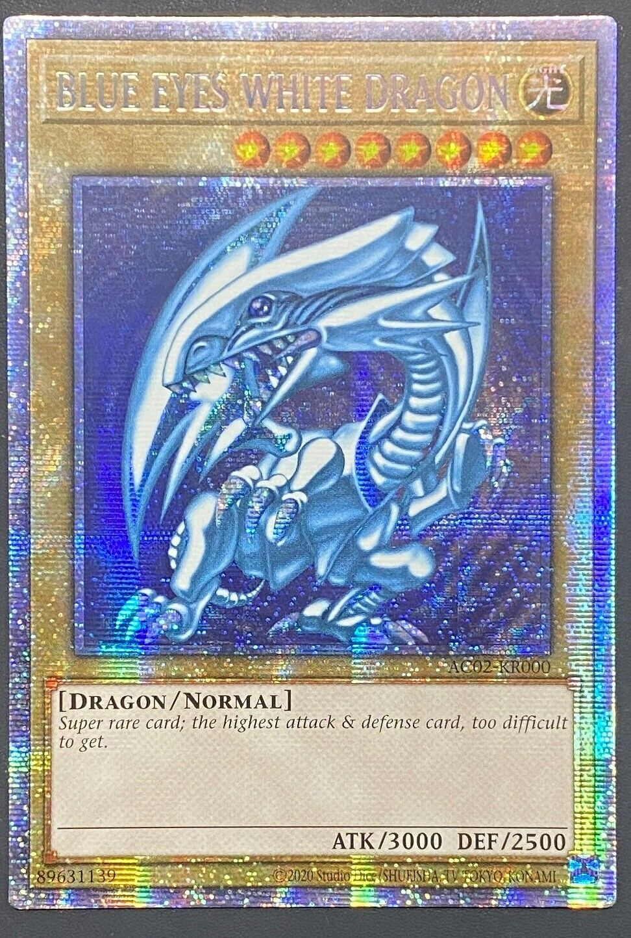
Stage 1: Why did it succeed?
The immediate success of the game revealed a completely new and growing game market, collectible cards
Became a cultural phenomenon with other competitors jumping into the market
Pokemon TCG released in 1996 in Japan
Yu-gi-oh TCG released in 1999
MtG became the “grandfather” of card games
Overcame temporary craze and novelty of its existence to endure for over 3 decades
Spawned new careers as a result of its success, setting the foundation for professional tabletop gaming

Slide 8
Stage 1: obtaining cards
Boosters
Box Sets
Singles
Retail Stores
Online Stores
Individual Vendors (eBay, etc)

Slide 9
Stage 1: Summary & Questions
During this stage, we covered a brief history of Magic the Gathering, what it is, its role in defining a cultural phenomenon, and where to obtain magic cards.
Questions for me
Questions for you
What year did Magic the Gathering make its debut?
If you wanted to obtain Magic cards, where would you go and why?

Slide 10
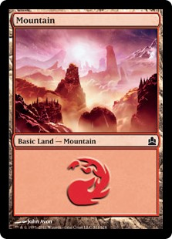
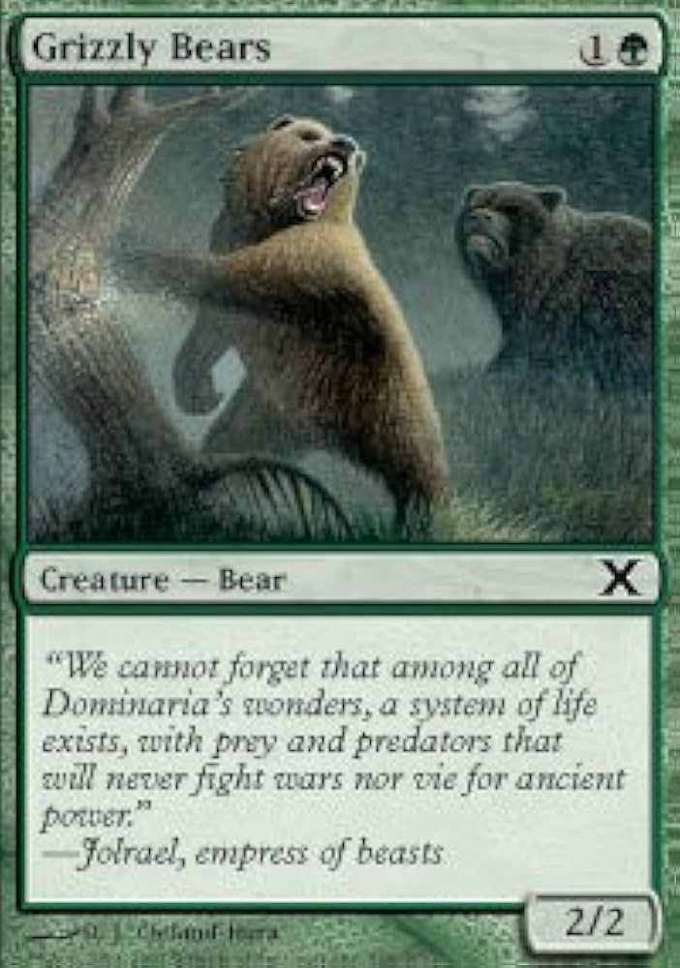
Stage 2: How to Play
During this stage of the lesson, I’ll go over some fundamental rules of how to play Magic The Gathering
Lands and Spells
Spells are what you cast to play the game
Lands are the resources you draw power from to cast your spells

Slide 11
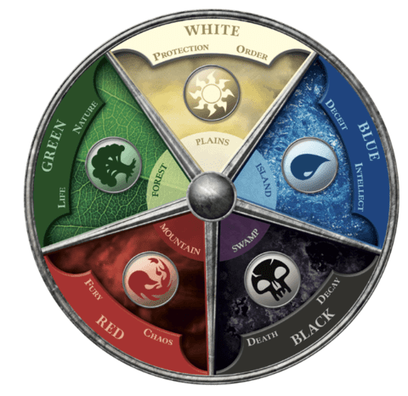
Stage 2: Colours
Spells are comprised of 5 colors, categorized into different geographical regions (lands)
Not just different resource types, but also signify ideological factions and principles, having unique strengths, weaknesses, and mechanics

Slide 12
Stage 2: Colours
Plains
Produce white colour mana
Represent peace, structure
Often have healing and protective effects
Uses strength of cooperation & discipline to assemble powerful armies out of smaller creatures that make the whole group stronger with their abilities
Islands
Produce blue colour mana
Represent knowledge, deliberation, deceit
Adaptable, focus on gaining advantage by countering, outsmarting, or tricking players
Swamps
Produce black colour mana
Represent power, death, sacrifice
Variety of different effects to debilitate or destroy creatures, leech life, or return fallen comrades back into play
Faustian Bargains

Slide 13
Stage 2: Colours
Mountains
Produce red colour mana
Represent freedom, action, and destruction
Often very aggressive, channeling powerful offensive spells for direct damage & destroying support cards
Forests
Produce green colour mana
Represent nature, connection, spirituality
Focus on growth & strength, typically have some very hard-hitting powerful creatures or quickly generating many weak creatures, boosting other creatures, or regenerating them

Slide 14
Stage 2: Generating mana resources (‘Tapping’)
->

Slide 15
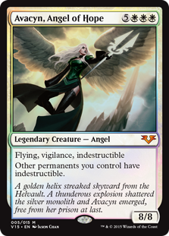
Stage 2: Spell cards ANATOMY
MANA COST
Generic Number + Coloured Mana Symbol
5 (any colour) + 1 (white) + 1 (white) + 1 (white) = 8
Type
Creature, Artifact, Enchantment, Instant, Sorcery, Planeswalker
Subtype
Angel
Expansion Symbol & Rarity Colour
Rules Text
Any abilities or effects the card has
Power & Toughness
Power = Damage it deals when attacking
Toughness = Hit Points
Flavour Text

Slide 16
Stage 2: Playing a Spell
Declare the card
Tap the mana cost to play it
Pause to allow opponent to respond
If a spell has a target (ex: an Instant or a Sorcery spell), must declare the target when announcing the spell.
If target disappears, the spell fizzles out

Slide 17
Stage 2: starting the game
Determine who starts (dice roll, coin flip, decision, etc.)
Shuffle Deck (card amount varies by type of game – 60 is standard)
Draw a starting hand of 7 cards
Option to mulligan

Slide 18
Stage 2: Turn order
Start
Untap
Clean Up
Beginning Phase
Main Phase 1
Combat
Main Phase 2
End Phase
Clean-up
Upkeep
End Phase
Draw
Main Phase 1
Can play one land per turn
Cast a spell
Main Phase 1
Same as first
If you already played a land this turn, can’t do it again
Combat
Declare attackers, declare blockers

Slide 19
Stage 2: Combat
Active players declares which creature(s) they are attacking with (attacking creature is tapped)
Opposing player chooses which available creature(s) block the attacks
Any number of untapped defending creatures can block a single attacking creature
When multiple creatures block an attacker, the attacker chooses how the damage is spread out
The attacker also takes damage from the blocking creature(s) equal to their power
Unblocked creatures deal direct damage to opponents
Creatures that take damage equal or greater than their toughness are destroyed (graveyard)
Once combat phase ends, creatures are no longer considered attacking or blocking

Slide 20
Stage 2: Spell Stack
All spells resolve using the stack
Stack allows players to respond to the spells being cast, normally with an Instant
When players have no more actions to take, the spells resolve from the top of the stack down
First in, Last out
Ex: Opponent casts Shock (Instant spell dealing 2 damage to any target), selecting your 2/2 bear as the target. If this resolves, it will kill the bear
You respond by playing Giant Growth (Instant spell granting +3/+3 to a target until end of turn)
Giant growth resolves first (bear gets +3/+3), then shock deals 2 damage (bear survives)
However, if your opponent responds by casting another Shock, the last spell (Shock) will resolve first, dealing 2 damage to the bear and killing it before the Giant Growth can boost its stats. The first shock no longer has a valid target (bear is dead) and fizzles out.

Slide 21
Stage 2: Ending a game
Each player has a life total, usually set to 20 points. If they take enough points of direct damage to their life total, they lose the game.
When a player runs out of cards to draw from their deck, they lose the game.

Slide 22
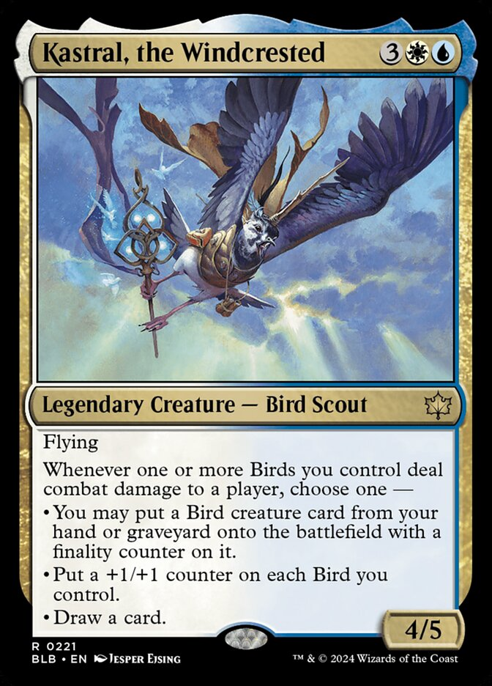
Stage 2: Summary & Questions
During this stage we learned the basic rules of how to play Magic the Gathering, including the most basic level of cards, the different colours, how to read the information on a card, how to play cards, the structure of a turn, how a spell stack resolves, and the conditions for winning and losing a game.
Questions for me
Questions for you
How many different colours of mana are there in Magic the Gathering and what are they?
What is the total mana cost to play this card?

Slide 23
Final summary
Today we covered what Magic the Gathering is and went over some basic rules on how to play it.
Questions
Thank you for your time, you’ve been a great class. I hope you can use the information you learned from this lesson to create some fun experiences and friendships playing Magic the Gathering!

